Slide 1

Dishonest behaviour by health and care professionals: exploring the views of the general public and professionals

Slide 2
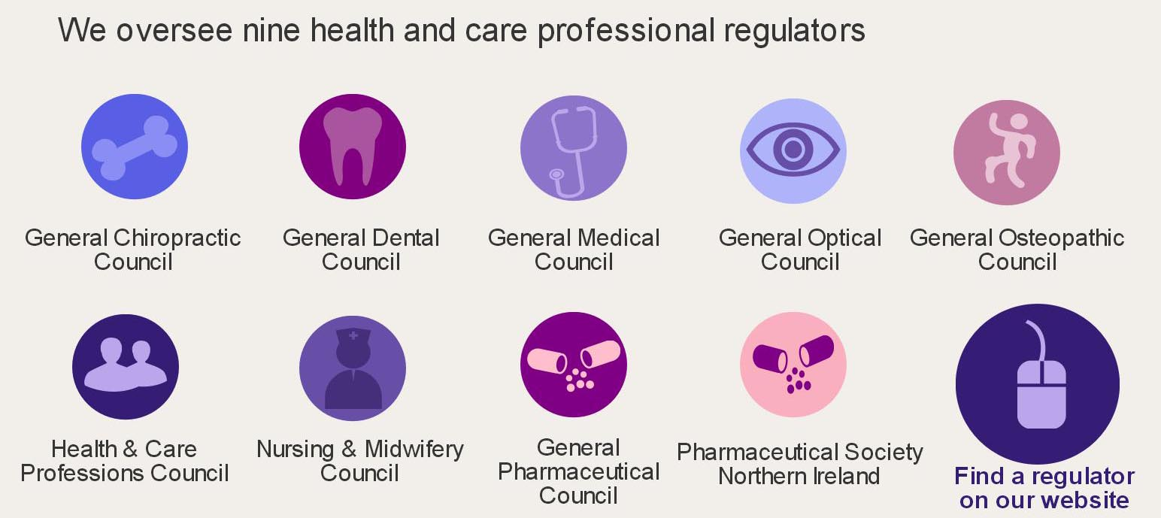
The Professional Standards Authority
Notes:
Intro
Name
I’m from the Professional Standards Authority for Health and Social Care (the Authority). We are an independent body, accountable to the UK Parliament and our role is to promotes the safety and wellbeing of patients and the public in the UK by raising standards of regulation and voluntary registration of people working in health and care.
Some of our key functions include
Oversee the performance of nine health and care professional regulators
Accredit voluntary registers of health and social care practitioners who are not regulated by law
Advise the four UK governments on improvements to regulation
Conduct research, promote right-touch regulation and publish papers on regulatory policy and practice
Carry out international commissions and reviews

Slide 3
Our interest in dishonesty
Authority legal team reviews regulator complaints cases
Currently around 3300 cases involving dishonesty on our database of cases reviewed
Significant number where dishonesty was being treated too leniently
Keen to explore whether public perceptions in line with Authority position and consider different factors that would affect perception
Notes:
Interest in dishonesty
Our legal team reviews all of the complaints cases from all of the nine regulators - can appeal to the High Court if too lenient
There are currently around 3300 cases involving dishonesty on our database of cases reviewed, one of the most common themes
We are seeing a significant number where it was felt that dishonesty hadn’t been taken into account properly – outcomes too lenient
The Courts seem to agree – we have won majority of these appeals
Previous proposals last year on reforming professional regulation in the UK last year suggested that regulators were taking an overly strict view of dishonesty and interfering unduly in registrants private lives
Wanted to explore this and assess whether public perceptions were in line with the Authority position and consider different factors that would affect seriousness of dishonesty

Slide 4
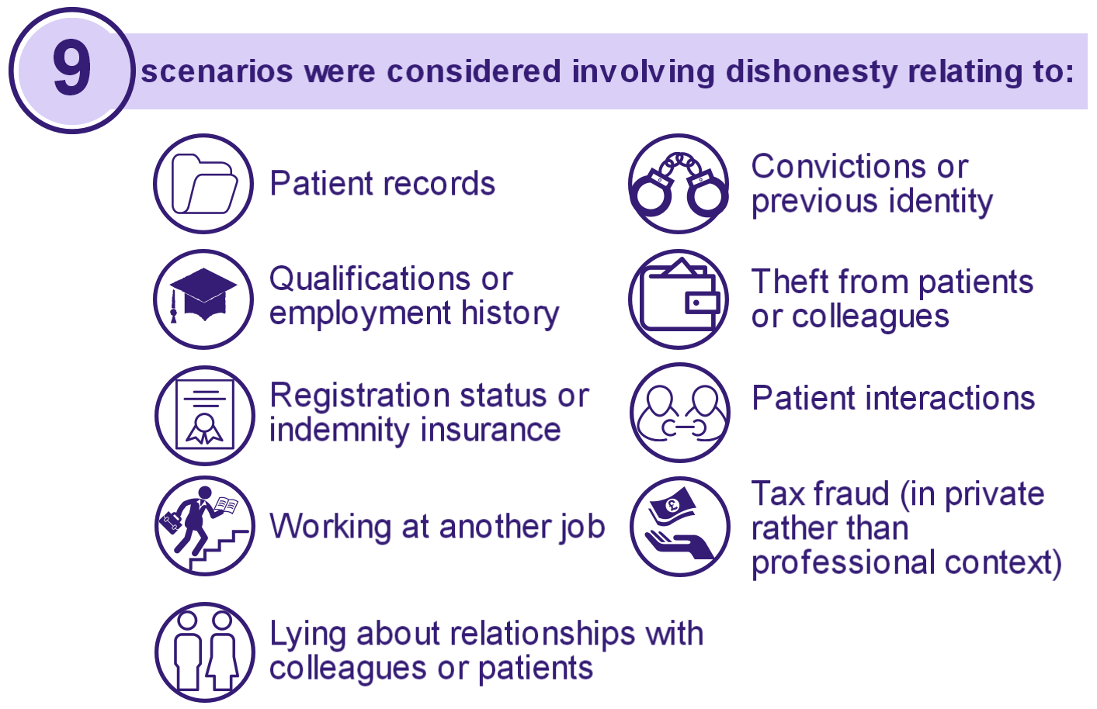
9 dishonesty scenarios considered by focus groups
Notes:
Research
Qualitative research carried out by research company Policis – used a range of focus groups made up of professionals and the public
Focus groups were asked to consider a range of scenarios relating to dishonest behaviour
We used real cases that had been scrutinised and appealed by the Professional Standards Authority under our powers
These were anonymised and covered a range of different situations
Participants were asked to discuss the issues presented and their reactions to the both the cases themselves and also the sanctions imposed by the regulators and any changed sanctions following appeal by the PSA to the High Court
Eight focus groups
Four groups of members of the public/consumers – range of ages, backgrounds and levels of usage of health services
Four groups of regulated professionals both healthcare and other sectors e.g. architects
Six in depth interviews with older consumers living in care homes/dependant on carers

Slide 5
Research findings
Shared concern about cases direct risk to public safety or a significant risk to public confidence
Different perceptions of professions - the stuff of souls v. a mechanic
Gender and generational differences
Shared view on repeat/planned dishonesty
Public support for learning and rehabilitation
Notes:
Findings
Shared view of cases involving dishonest behaviour from the public and professionals – particularly where there was a direct risk to public safety or a significant risk to public confidence in the profession - a feeling that cases of dishonesty were dealt with too leniently by the regulators
Differing attitudes depending on the perceptions of the profession e.g. social workers = the stuff of souls, dentist = mechanic - a social worker who ran an unregulated childcare business alongside her work commitments was seen in a much worse light than a dentist who had carried out tax fraud with his personal finances
Clear gender and generational differences particularly relating to cases of professional boundaries or sexual misconduct – older men more likely to be more forgiving of advances by a doctor to a female patient – however when it was show that the doctor who has propositioned his patient had done it before, all participants saw this as much more serious
Some variations but both professionals and the public had a shared view of what were seen as aggravating or mitigating factors
Consensus that premeditated, systemic or long standing dishonesty in the context of financial gain or sexual exploitation should be grounds for being struck off the register – more leniency for being in a junior position, a one off incident or showing insight or remorse
Generally a greater level of support from professionals and the public for behaviour change and learning and rehabilitation to allow registrants to continue in the profession where possible.
Greater focus by professionals than the public on the importance of professional boundaries and ethics = reputation of the profession

Slide 6
Implications of research
Further research by the regulators
Set of principles - mitigating/exacerbating factors
Further exploration – links between private dishonesty and confidence in the profession
Research into retraining and rehabilitation
Collaboration between professional and system regulators to avoid scapegoating
Notes:
Implications
Haven’t yet decided on which of these to progress but some implications – please do offer any additional suggestions in the questions
Further research into public attitudes to dishonesty, possibly by the regulators looking at the difference in attitudes to dishonest behaviour by the different professions
Development of a set of principles/guidance for panels to ensure consistent approach to cases where the issue is the risk to public confidence and highlighting mitigating and exacerbating factors
Further information and transparency on the link between private dishonesty and the effect on other behaviours or public confidence in the profession
Greater consideration of the support for retraining and rehabilitation where the individual demonstrates insight, further research
More focus on collaborative working between professional and system regulators to ensure systemic issues are addressed and individuals do not end up being made scapegoats for broader problems
Additional research - - dishonesty typology – preventative work - tackling the causes of dishonesty through education and training for medical

Slide 7
Questions?
Reactions to the research
International comparisons – ways that dishonesty is dealt with
Suggestions on further areas of research
Next steps – how could this be used?

Slide 8
Read the full report at - http://www.professionalstandards.org.uk/publications/detail/research-dishonest-behaviour-by-professionals
Daisy Blench daisy.blench@professionalstandards.org.uk
www.professionalstandards.org.uk
Notes:
Question – for detailed questions about the research methodology or about our work reviewing cases might need to get back to you but please do ask anything or it would be interesting to hear any perspectives on this research or proposals for how we take the work forward

